Slide 1
Azure Storage and the Azure CLI
Microsoft Research

Slide 2
Azure Storage
Store data cheaply, reliably, and with high availability
Accessible anywhere and in any programming language
Blobs
Tables
Queues
Files

Slide 3
Azure Storage Accounts
Storage-account name forms part of the path to an item
e.g., a4rlabs.blob.core.windows.net/container-name/blob-name
Storage-account names must conform to these rules:
Must be unique within Azure
3 to 24 characters in length
Contain numbers and lowercase letters only
The basis for billing
Charges based on storage volume, replication scheme, number of read/write operations, and data egress across regions
See http://azure.microsoft.com/en-us/pricing/details/storage/

Slide 4
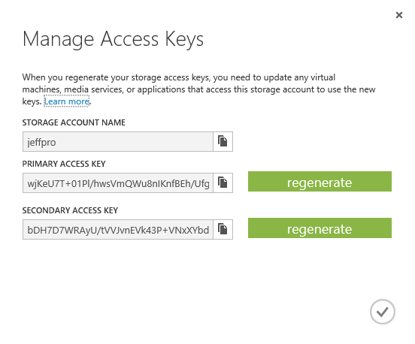
Access Keys
Access to storage by non-account-owners relies on keys for authentication
Two 512-bit keys per account
Keys should be "rolled" periodically for security
Keys can be used to generate shared-access signatures (SASes) for time-limited access

Slide 5
Blob Containers
All blobs must reside in a container
Storage account can have unlimited number of containers
Container can hold an unlimited number of blobs
Container name forms part of the path to a blob
e.g., a4rlabs.blob.core.windows.net/container-name/blob-name
Container names must meet the following criteria:
3 to 63 characters in length
Lowercase letters, numbers, and non-consecutive dashes (-)
Containers cannot be nested

Slide 6
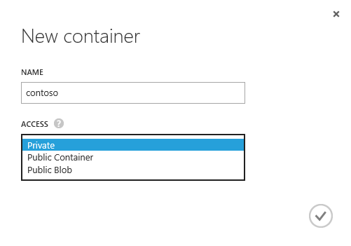
Container Access Policy
Each container is assigned one of three access policies
Private – Blobs can't be read anonymously or enumerated
Public Container – Blobs can be read anonymously, but cannot be enumerated
Public Blob – Blobs can be read anonymously and enumerated

Slide 7
Blobs
Store data as a unit like files in file systems
Each blob can contain up to ~200 GB of data*
Blob name forms part of the path to the blob
e.g., a4rlabs.blob.core.windows.net/container-name/blob-name
Blob names must conform to the following rules:
1 to 1,024 characters in length
Can contain any type of characters (including forward slashes)
Cannot contain more than 254 path segments
Reserved URL characters must be properly escaped
Blob names are case-sensitive

Slide 8
Demo
Getting Started with Storage

Slide 9
Azure Storage Tools
Portal doesn't provide functionality for uploading blobs
Other tools fill the gap (many free and open-source)
Azure Storage Explorer, AzCopy, and Azure PowerShell (Windows)
blobxfer (Linux and OS X)
Azure Command-Line Interface, or CLI (cross-platform)
Zudio (cross-platform, browser-based)
And many more…
You don't have to run Windows to manage blobs!
See http://storagetools.azurewebsites.net/ for more

Slide 10
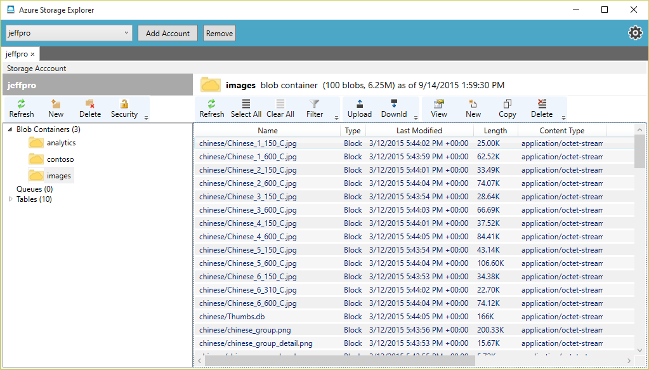
Azure Storage Explorer (Windows)
http://azurestorageexplorer.codeplex.com/

Slide 11
blobxfer (Linux and OS X)
https://github.com/Azure/azure-batch-samples/tree/master/Python/Storage
Container name
Local file name and blob name
blobxfer a4rlabs contoso banner.jpg
--storageaccountkey [accountkey]

Slide 12
Azure CLI (All Platforms)
https://azure.microsoft.com/en-us/documentation/articles/xplat-cli/
Local file name
Container name
Blob name
azure storage blob upload banner.jpg images banner.jpg
-a a4rlabs -k [accountkey]

Slide 13
Demo
Uploading a Blob

Slide 14
Scripting the Azure CLI
CLI commands can be scripted to automate common storage tasks such as uploading groups of files
# Bash script for uploading JPG files in current directory
# to "images" container in "a4rlabs" storage account
for f in *.jpg
do
azure storage blob upload -a a4rlabs
-k [accountkey] "${f##*/}" images "${f##*/}"
done

Slide 15
Hands-On Lab
Azure Storage and the CLI
StorageHOL.pdf

